Slide 1

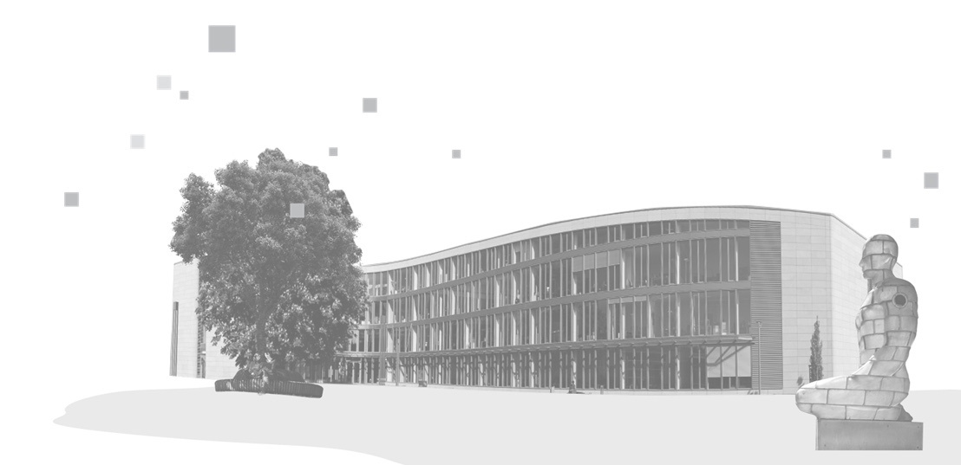

Reinforcement Learning I –
How Agents Learn by Trial and Error

Slide 2

Attendance List
kisz@hpi.de
hpi.de/kisz

Slide 3
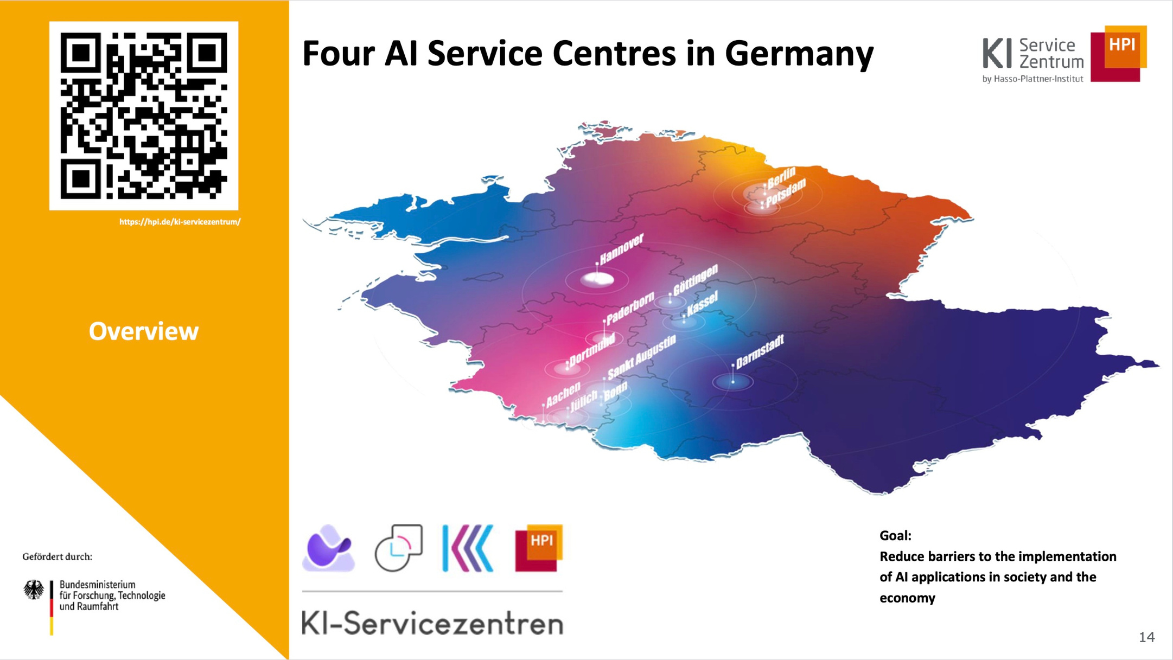


Slide 4


Slide 5
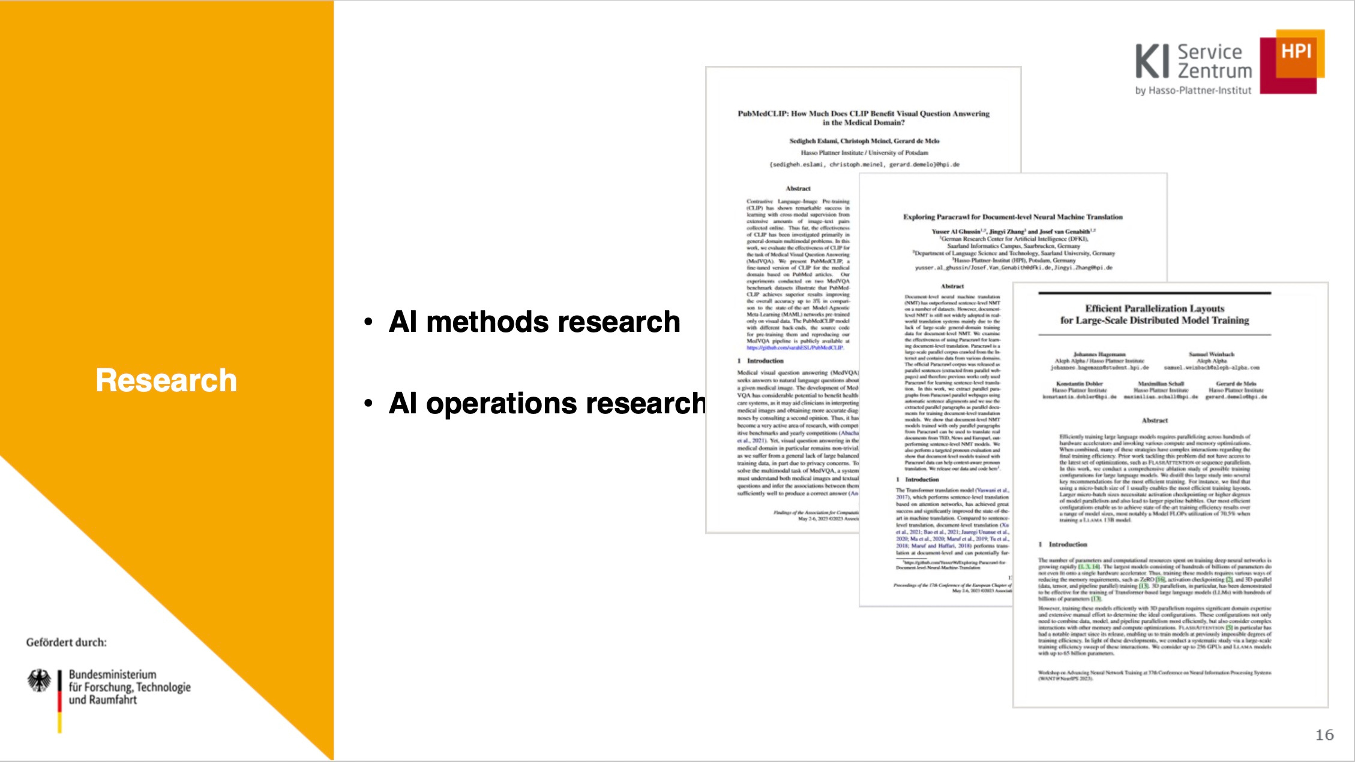

Slide 6


Slide 7


Slide 8
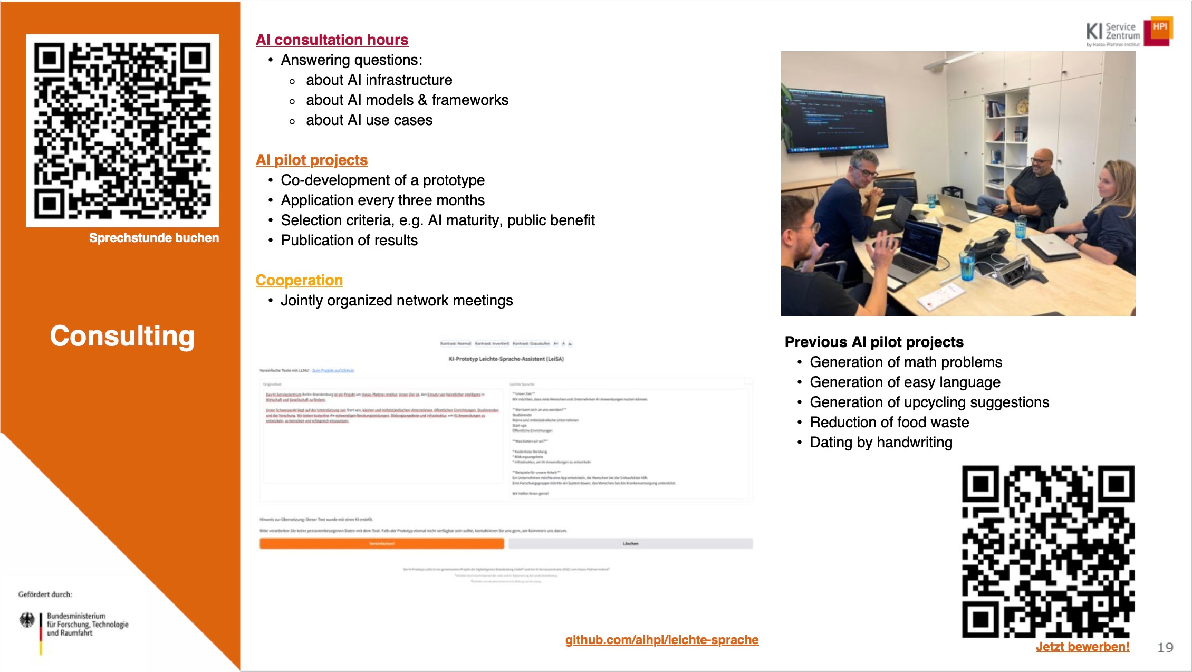

Slide 9
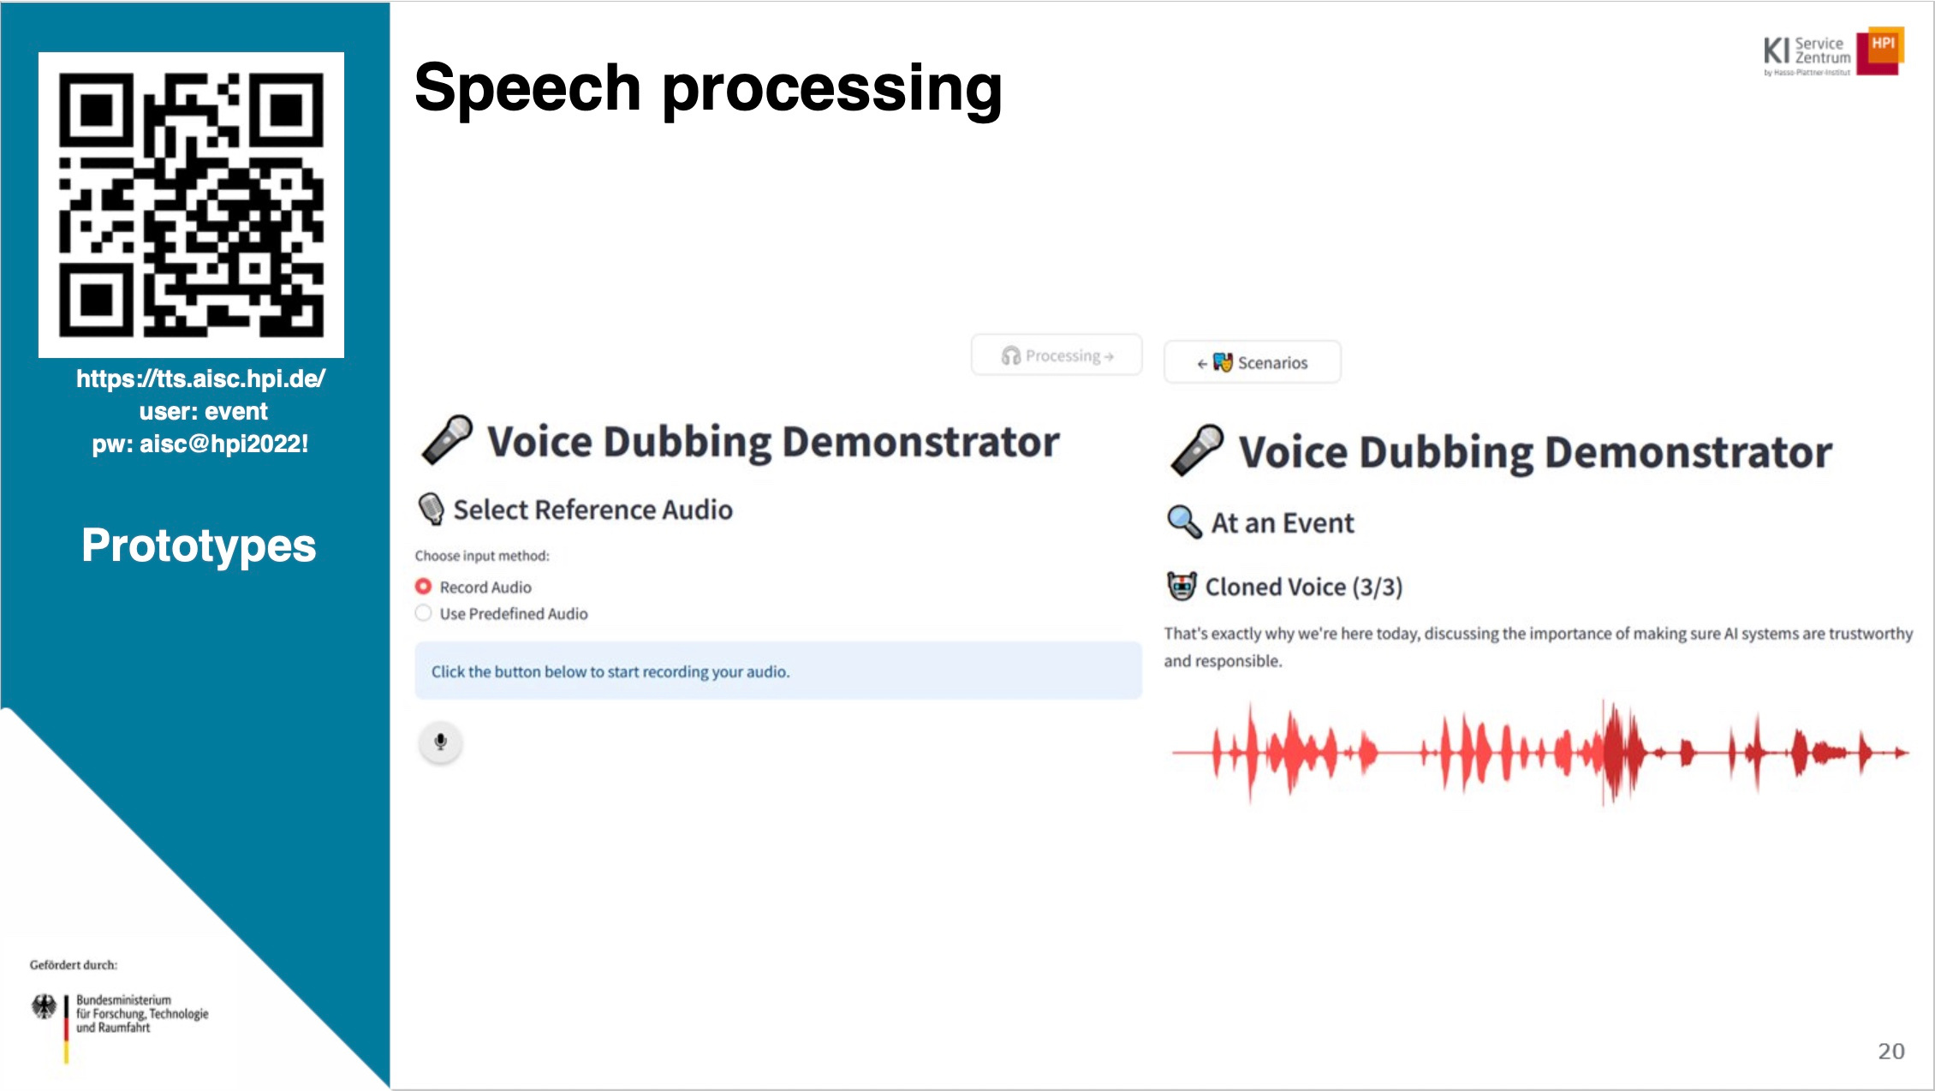

Slide 10
Reinforcement Learning I –
How Agents Learn by Trial and Error

Slide 11
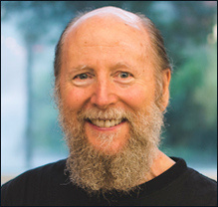
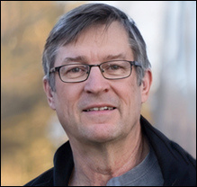
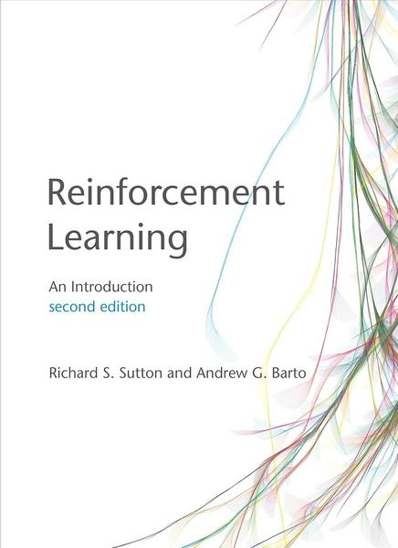
Motivation and context |
“Of all the forms of machine learning, reinforcement learning is the closest to the kind of learning that humans and other animals do.” - Richard Sutton, Andrew Barto
kisz@hpi.de
hpi.de/kisz
source of pictures: https://amturing.acm.org

Slide 12
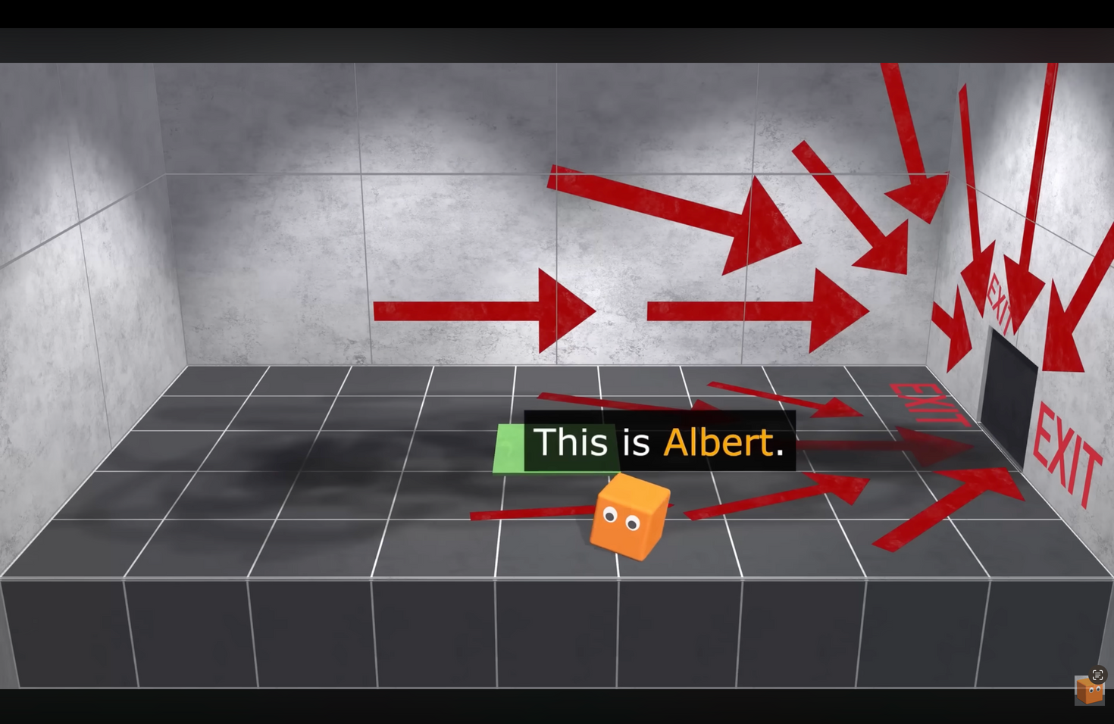
Motivation and context |
“Of all the forms of machine learning, reinforcement learning is the closest to the kind of learning that humans and other animals do.” -Richard S. Sutton
kisz@hpi.de
hpi.de/kisz
AI Warehouse - https://www.youtube.com/watch?v=v3UBlEJDXR0

Slide 13
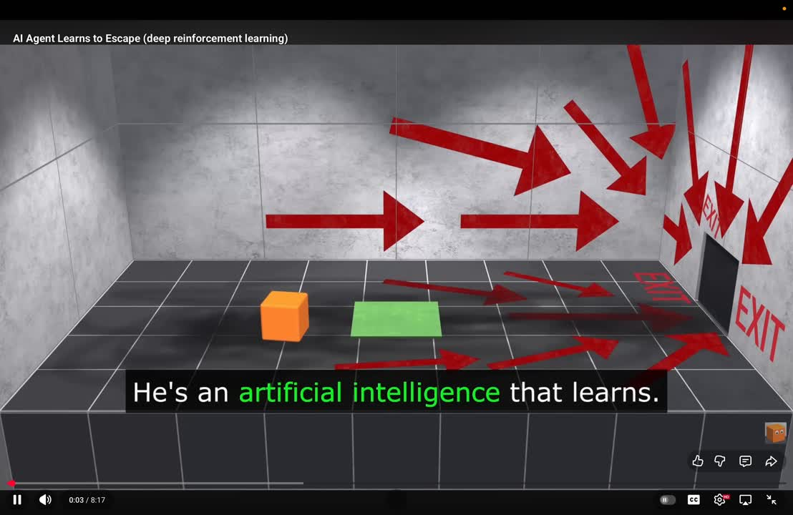
Motivation and context |
“Of all the forms of machine learning, reinforcement learning is the closest to the kind of learning that humans and other animals do.” -Richard S. Sutton
kisz@hpi.de
hpi.de/kisz
AI Warehouse - https://www.youtube.com/watch?v=v3UBlEJDXR0

Slide 14
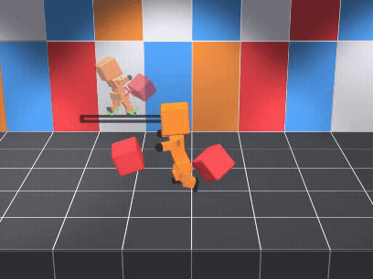
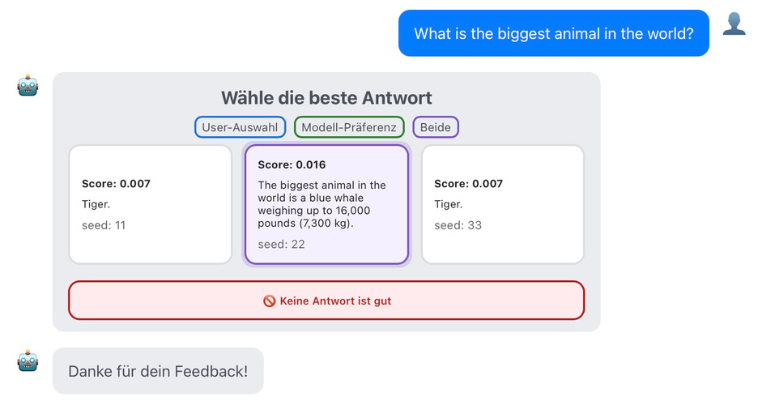
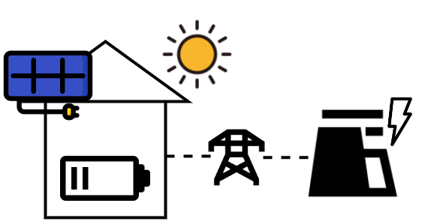
Motivation and context ||: Applications
kisz@hpi.de
hpi.de/kisz
Robotics
AI Warehouse
https://www.youtube.com/watch?v=L_4BPjLBF4E&t=60s
Control Energy Systems
RLHF for Chatbots
https://github.com/tobirohrer/building-energy-storage-simulation

Slide 15
Motivation and context |||
kisz@hpi.de
hpi.de/kisz
Supervised Learning
Reinforcement Learning
Unsupervised Learning
Models are trained on labeled data to predict outputs
Learning optimal behavior by interacting with an environment
Learn to identify previously unknown patterns and relationships in unlabeled data
used when optimal actions are too complex or unknown to define but can be learned through experience

Slide 16
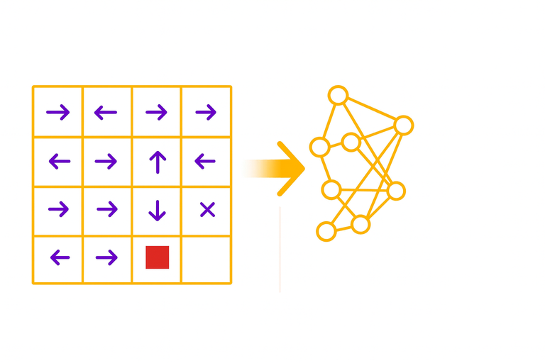
What will we cover today?
kisz@hpi.de
hpi.de/kisz
Today
Following workshops
Basic concepts
”Hello World” of RL:
Q-learning on FrozenLake environment
Build intuition about learning parameters
First Coding
Deep RL
When to apply which algorithm
How to set up a RL problem
Real-world applications

Slide 17
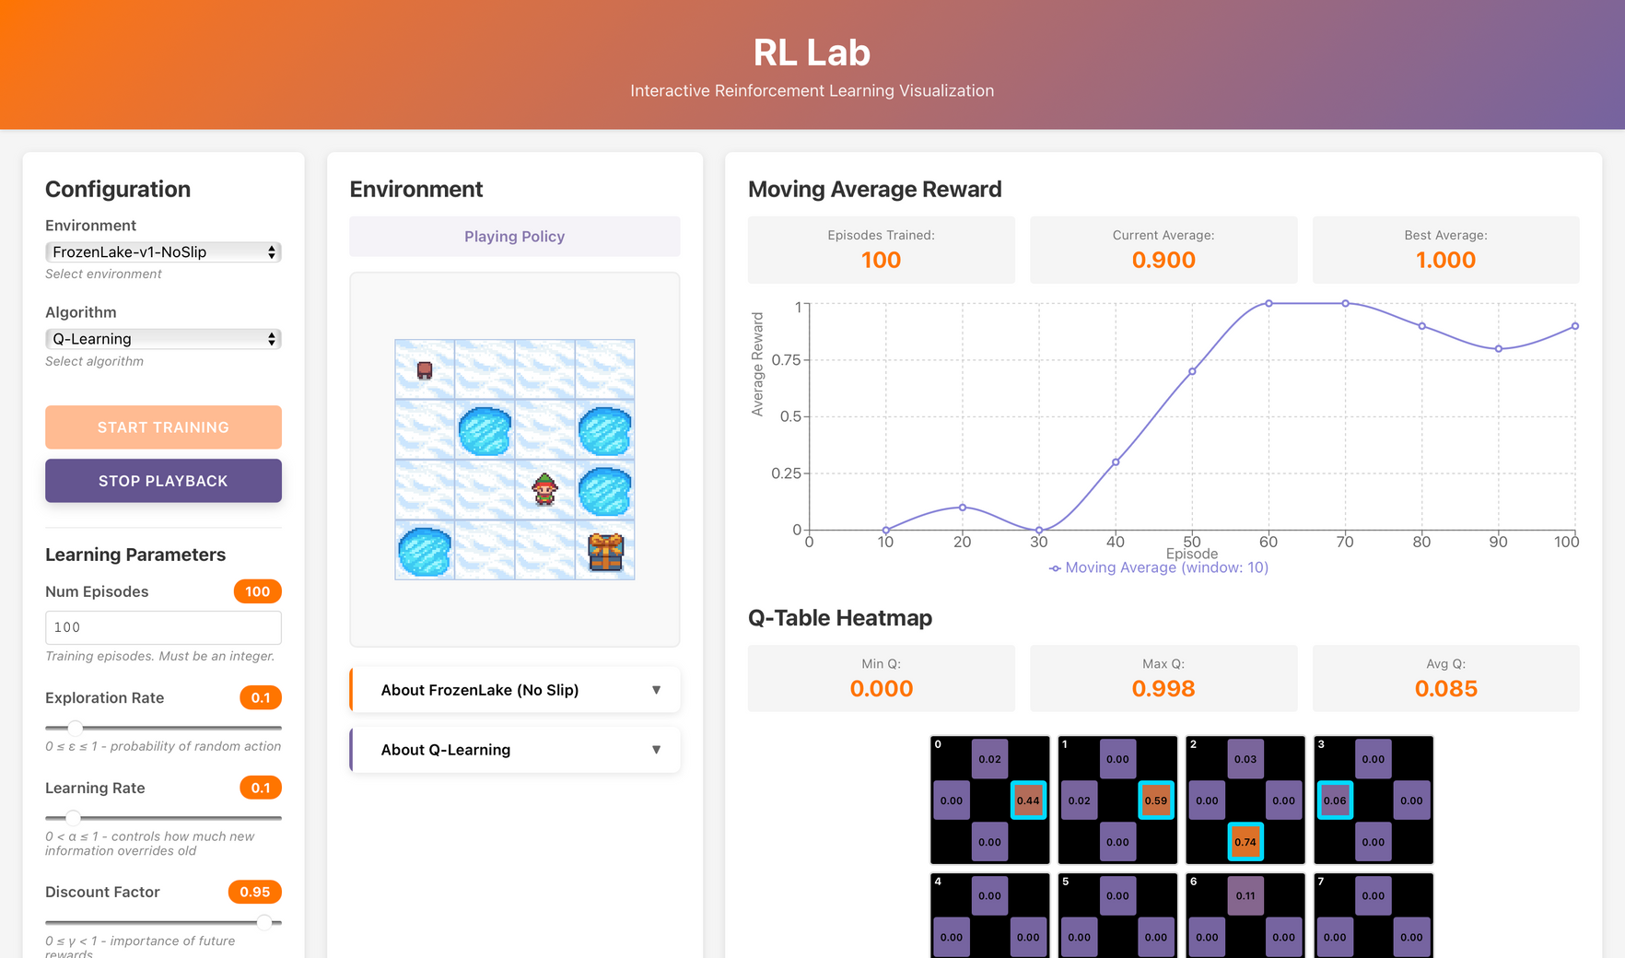
What will we cover today?
kisz@hpi.de
hpi.de/kisz

Slide 18



Key terms
kisz@hpi.de
hpi.de/kisz
Agent
Agent
An agent takes actions, gets feedback, and learns what works best

Slide 19



Key terms
kisz@hpi.de
hpi.de/kisz
Environment
The environment is the world the agent interacts with. It defines what happens when the agent takes an action.

Slide 20


Key terms
kisz@hpi.de
hpi.de/kisz
State
The state is the agent’s current situation, what it perceives in the environment

Slide 21





Key terms
kisz@hpi.de
hpi.de/kisz
Policy:
“Use the watering can”
Policy
The policy is the strategy or rule that tells the agent which action to take in a given state

Slide 22

Key terms
kisz@hpi.de
hpi.de/kisz
Action
An action is the agent’s behavior at a specific moment

Slide 23


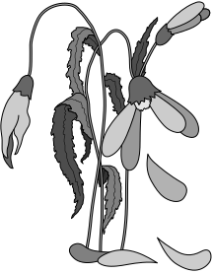
Key terms
kisz@hpi.de
hpi.de/kisz
Reward
A reward is feedback indicating if an action was good or bad

Slide 24

Key terms
kisz@hpi.de
hpi.de/kisz
Timestep
Agent
A timestep is one interaction with the environment
State
Action
Reward
Environment

Slide 25

Key terms
kisz@hpi.de
hpi.de/kisz
Episode
An episode is a finished sequence of interactions forming one complete task run
Policy abhängig vom Reward anpassen
Die Policy wählt eine Action abhängig vom State
Policy abhängig vom Reward anpassen
Die Policy wählt eine Action abhängig vom State
Policy abhängig vom Reward anpassen
Die Policy wählt eine Action abhängig vom State
task start
Agent
Agent
task end
State
State
State
Agent
Action
Action
Action
Reward
Reward
Reward
Environment
Environment
Environment

Slide 26
How does the agent evaluate situations? |
kisz@hpi.de
hpi.de/kisz
How are actions chosen?

Slide 27
How does the agent evaluate situations? ||
kisz@hpi.de
hpi.de/kisz
How are actions chosen?
The policy chooses and adjusts actions using rewards and value estimates.

Slide 28


Algorithm
kisz@hpi.de
hpi.de/kisz
RL Algorithms
Model-Free
Model-Based
Value-Based
Learn
the
model
Q-learning
Actor-Critic
Policy-Based
Given
the
model

Slide 29

What are Q-values?
used for choosing the best action
higher Q-values
→ better actions
estimates how good an action is in a given state
?
Water flowers: Q = 0.8
Dig up flowers: Q = 0.2

Slide 30
Exploration vs. Exploitation
Exploitation
Choosing the best-known
action to get rewards
?
Water flowers: Q = 0.8
Dig up flowers: Q = 0.2
Exploration
Trying new actions to
discover better options
Water flowers: Q = 0.8
Dig up flowers: Q = 0.2

Slide 31

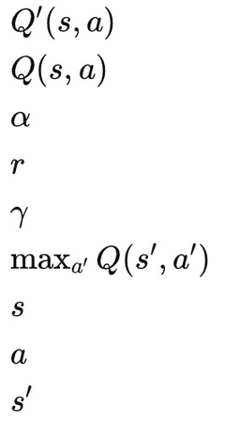
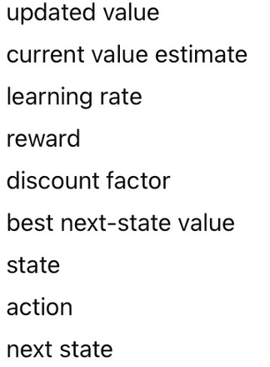
How are Q-values learned?
kisz@hpi.de
hpi.de/kisz
Q-values are not known at the beginning
new
Q-value
current
Q-value
new information

Slide 32
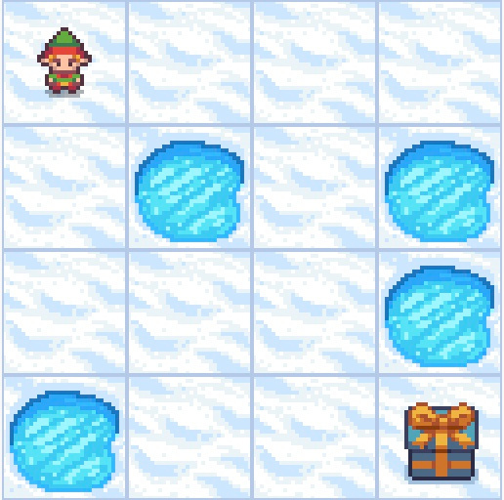

Example: Frozen Lake
kisz@hpi.de
hpi.de/kisz
State
= Position in the grid
Agent
Action
= if possible, left, right, up, down
Reward
= +1 for reaching the goal
0 for every step on a frozen tile
0 for falling into a hole
Policy
= choose the action with the best Q-value
Trap
Goal
Environment

Slide 33


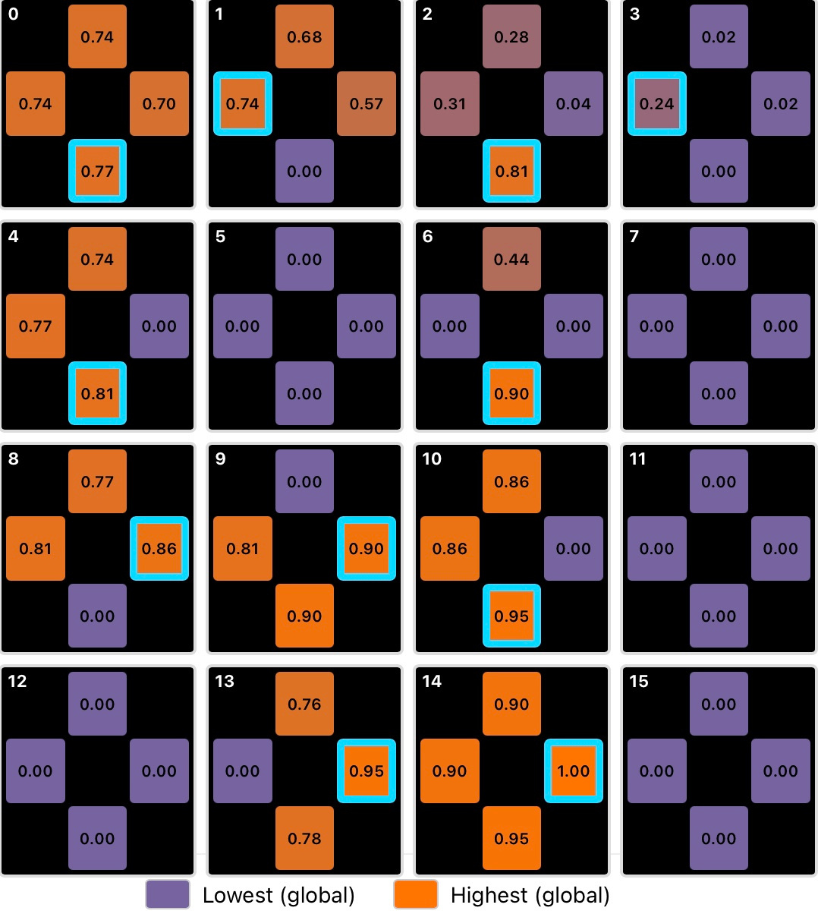
Example: Frozen Lake
kisz@hpi.de
hpi.de/kisz
Environment
Q-Table
Q-Table for
the starting position

Slide 34


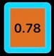
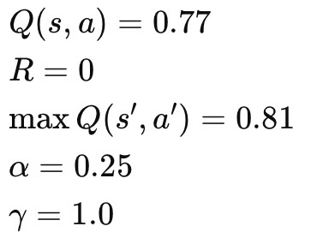
Example: Frozen Lake
kisz@hpi.de
hpi.de/kisz

Slide 35
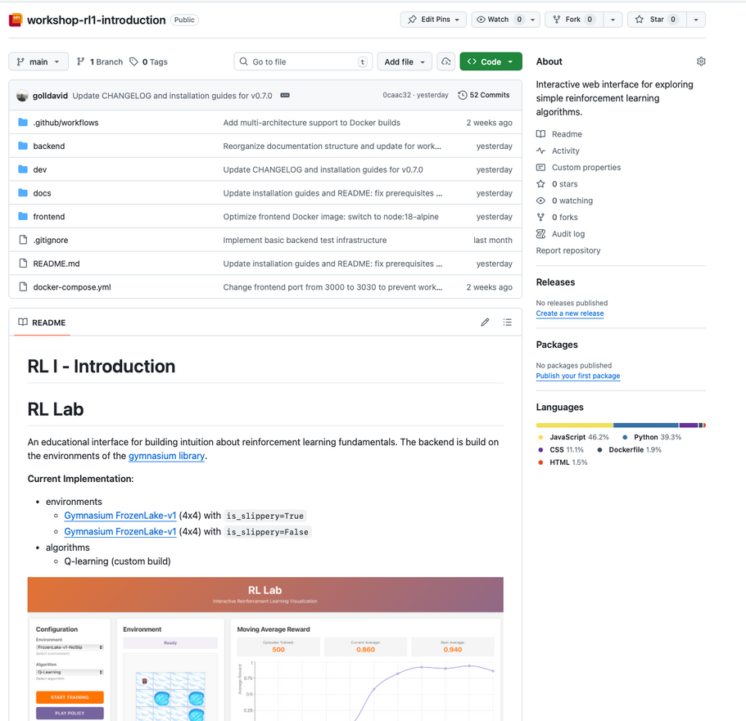
Try it out
https://github.com/aihpi/workshop-rl1-introduction
kisz@hpi.de
hpi.de/kisz

Slide 36
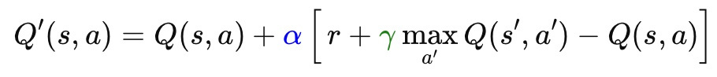
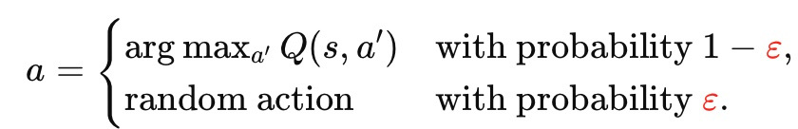
What learning parameters are there?
kisz@hpi.de
hpi.de/kisz
Parameter
Symbol
Meaning
Impact
learning rate
α
determines how strongly new information influences the previous Q-value
high values → fast but unstable learning
low values → slow but stable learning
discount factor
γ
weights future rewards relative to immediate rewards
high values → long-term focus
low values → short-term focus
exploration rate
ϵ
indicates how often random actions are chosen instead of the current best action
high values → explore many different actions
low values → exploit the learned action more
number of episodes
-
number of learning cycles the model goes through
few episodes → poor learning
many episodes → risk of overfitting, training time
initialization of Q-values
-
initial values of the Q-table
influences how quickly the model arrives at good decisions

Slide 37
Challenges in RL
kisz@hpi.de
hpi.de/kisz
Exploration vs. Exploitation
Reward Shaping
Learning Stability & Convergence
Balance between exploring new actions and exploiting known knowledge
Too much exploration → inefficient
Too little → gets stuck in poor strategies
Rewards must encourage the desired behavior
Poor or overly simple reward designs can lead to unexpected strategies (CAREFUL!)
Updates can become unstable or diverge
Sample Efficiency
Partial Observability
& Uncertainty
Scalability & Complexity
RL often requires many interactions
In real scenarios (e.g., robotics) this is costly or slow
Large state or action spaces make learning computationally expensive/infeasible
Often requires function approximation (e.g., neural networks)
The agent often cannot observe the full state of the environment
Must still make robust decisions

Slide 38



What have we learned so far?
kisz@hpi.de
hpi.de/kisz
Basics
Specifically
Potential and Limitations
Agent-Environment interaction
Policy learns to maximize long-term cumulative reward
Learning through trial and error
Parameters: α (learning rate), γ (discount factor), ε (exploration rate)
Q-Learning
Q-Value function: measures the expected future reward of an action in a specific state
Gym library (FrozenLake)
Potential: Provides a framework for continual learning via interaction (core idea of RL is closely related to biological learning)
Challenges: Sample inefficiency, sim2real, reward design, instability, safety,

Slide 39
Outlook
kisz@hpi.de
hpi.de/kisz
Deep Reinforcement Learning
Procedure in an RL project
Choice of algorithm
Current application areas

Slide 40
